Slide 1
Travel ai-agent
IBM AICTE PROJECT
Student name : JAY DEEPAK JADHAV
College Name : GH RAISONI COLLEGE OF ENGINEERING AND MANAGEMENT,PUNE
Department : COMPUTER ENGINEERING (CSE)

Slide 2
OUTLINE
Problem Statement
Technology used
Wow factor
End users
Result
Conclusion
Git-hub Link
Future scope
IBM Certifications

Slide 3
Problem Statement
Travel planning can be overwhelming due to the abundance of options for transportation, accommodation, activities, and budgeting. Many travelers struggle to find the best combinations that meet their preferences, budget, and timelines. Traditional travel agencies are often time-consuming, while online tools may lack personal touch and dynamic recommendations.
Proposed Solution: Design and build an intelligent Travel Agent AI Assistant that helps users plan end-to-end trips based on their preferences (budget, travel dates, interests, weather, visa requirements, etc.). The system should provide smart recommendations, cost estimations, and itinerary generation, and optionally enable booking assistance.

Slide 4
Technology used
IBM cloud lite services
Natural Language Processing (NLP)
Retrieval Augmented Generation (RAG)
IBM Granite model

Slide 5
IBM cloud services used
IBM Cloud Watsonx AI Studio
IBM Cloud Watsonx AI runtime
IBM Cloud Agent Lab
IBM Granite foundation model

Slide 6
Wow factors
This agent will significantly reduce research time, improve the quality of literature reviews, help early-stage researchers find direction, and foster interdisciplinary collaboration by making knowledge more accessible and actionable.
Unique features:
User Profile & Preference Capture:
Collect user's name, location, travel dates, budget, interests (adventure, culture, food, relaxation), etc.
Destination Recommendation Engine:
Suggest destinations based on weather, budget, safety, visa requirements, trending spots.
Itinerary Generator:
Create daily travel plans with sightseeing, rest time, meal suggestions.
Adjustable by user (drag/drop or AI optimization).
Budget Estimator:
Estimate total costs (flights, hotels, food, transport, tickets).

Slide 7
End users
Academic Researchers
Research Institutions and Universities
Industry R&D Teams
Educators

Slide 8
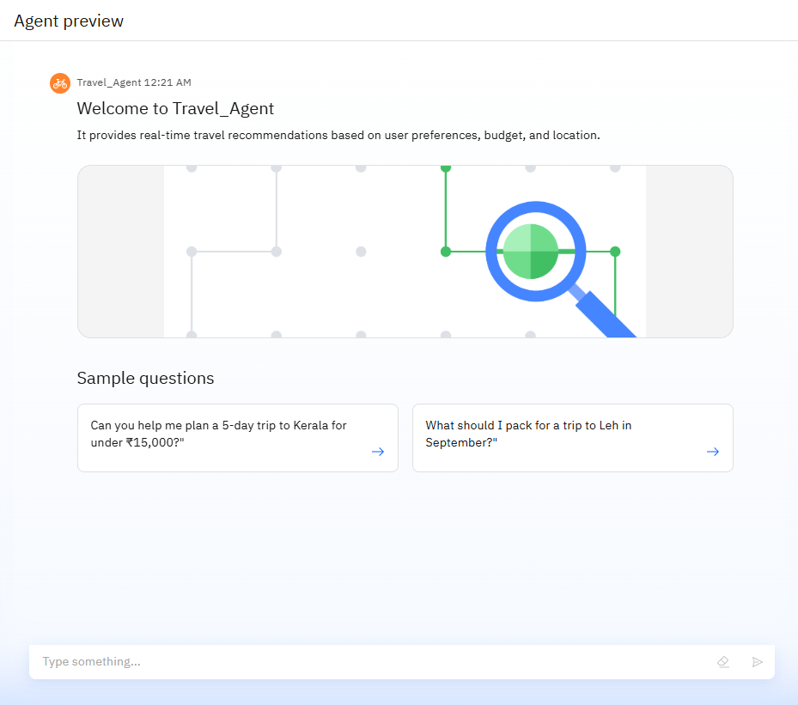
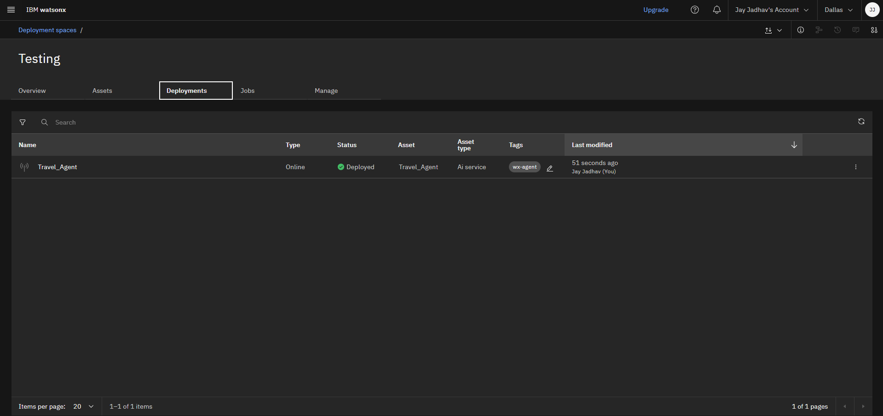
Results

Slide 9
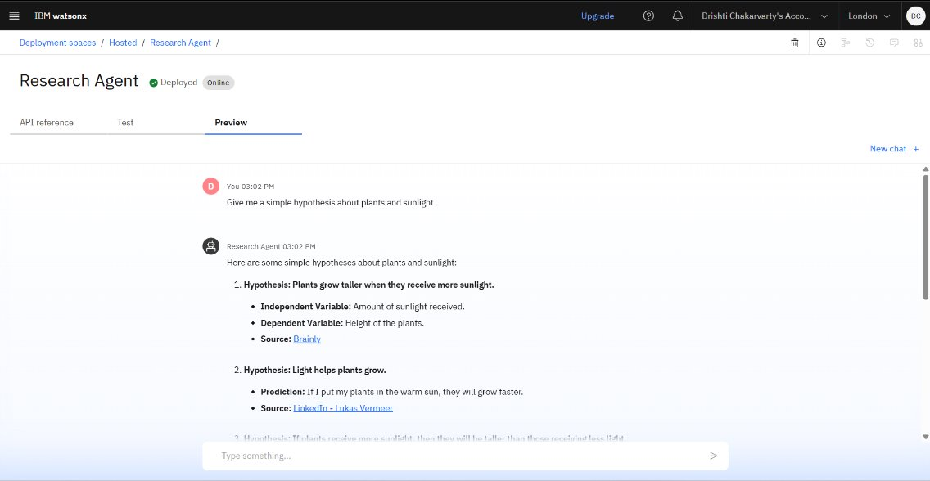
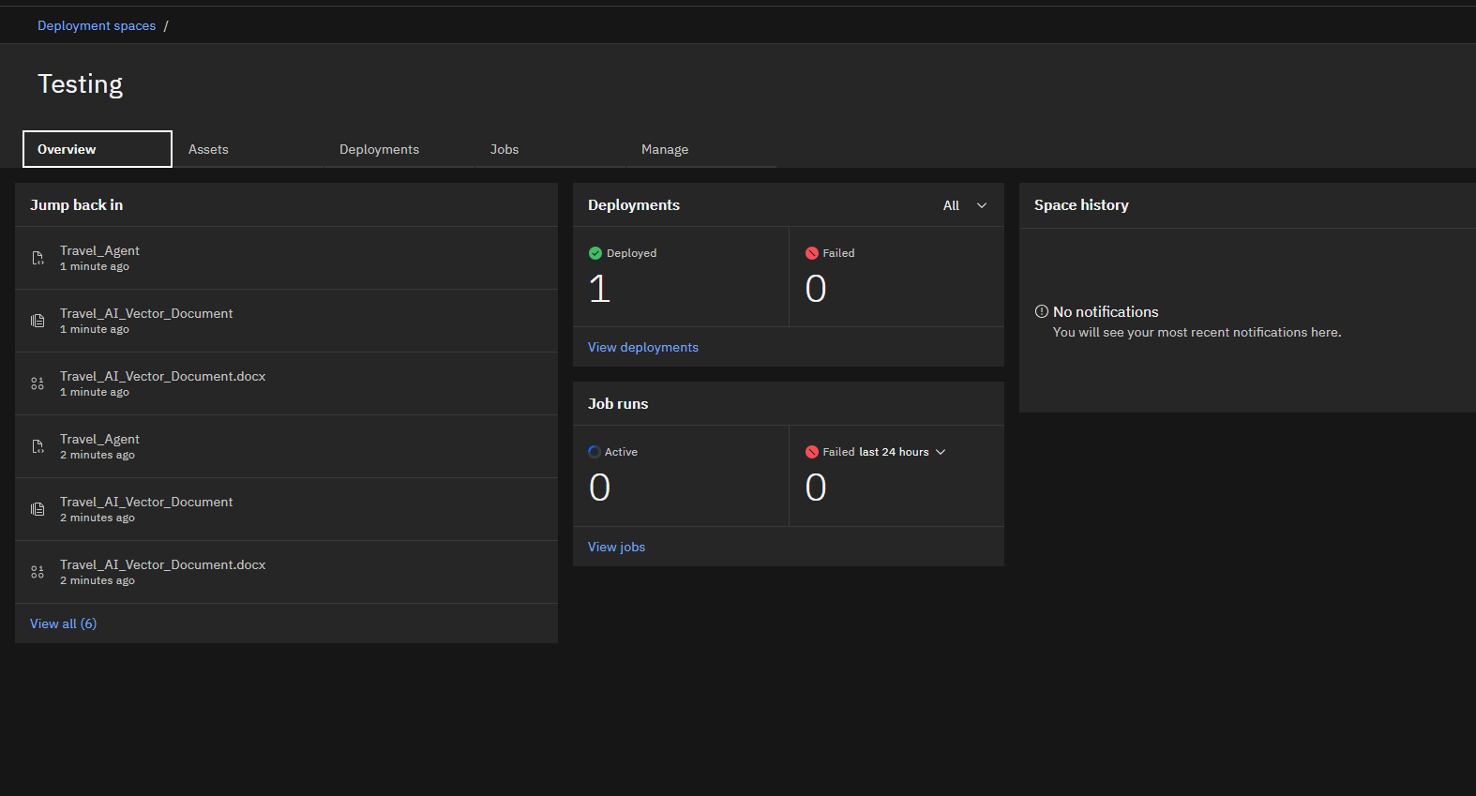
Results
Deployed AI Agent

Slide 10
Conclusion
The agent can generate reports, suggest hypotheses, and even draft sections of research papers.
It saves time by automating repetitive tasks like citation management and data extraction.
Research Agents enhance efficiency, accuracy, and innovation in both academic and industrial R&D.

Slide 11
GitHub Link
Make sure that there should be readme file

Slide 12
Future scope
Multilingual Research Support
Voice-Activated Research Assistant
Real-Time Collaboration Features
Research Gap and Novel Topic Identification
Integration with Publishing Platforms
AI-Assisted Paper Drafting

Slide 13
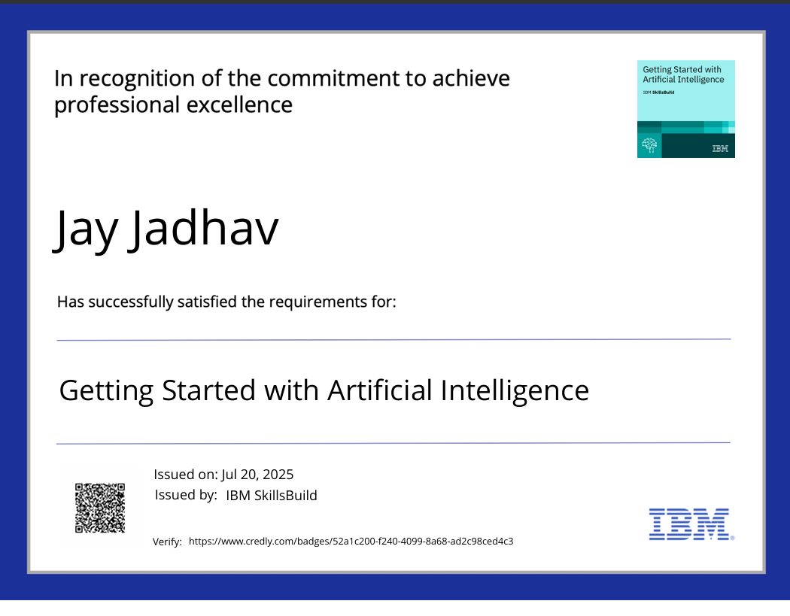
IBM Certifications
Screenshot/credly certificate( getting started with AI)

Slide 14
THANK YOU

